Slide 1
Building Web Applications
Mendel Rosenblum
CS142 Lecture Notes - Building Web Applications

Slide 2
Good web applications: Design + Implementation
Some Design Goals:
Intuitive to use
  Don't need to take a course or read a user manual
Accomplish task accurately and rapidly
  Provide needed information and functionality
Users like the experience
  Joy rather than pain when using the app
The hardest part of good web applications is the design
Outside the scope of this course (and instructor)!
Good user interface principles are encoded in the toolkits and style guides

Slide 3
Some guiding design principles for Web Apps
Be consistent
Cognitive load less for the user
Provide context
User shouldn't get lost in the app
Be fast
Don't make the user wait

Slide 4
Consistency: Style guides & design templates
Web apps should have a style guide - Covers the look and feel of the app
  Style - Color schemes, animation, icons, images, typography, writing
  User interactions - Menu, buttons, pickers, dialog boxes, tables, lists, ...
  Layout - Structure, toolbars, content, responsiveness
Patterns - If you do something multiple places do it the same way
  Aided by reusable implementation components
  Error handling, navigation, notifications, etc.
Design templates - Follow a familiar structure
  Example: Master-detail template

Slide 5
Style Guide Example: Material Design from Google
Used in Google apps (e.g Android, web apps)
  Influence by publishing (paper and ink) enhance with technology (3D look)
  Focus on traditional print issues: grids, space, typography, scale, color, imagery
  Heavy use of animation to convey action
Dictates many aspect of design
  Structure and layouts
  User interface
  Common patterns

Slide 6
Material Design Foundations
Environment - surfaces (e.g paper), depth, and shadows Layout - responsive layout grid, breakpoints, white space Navigation - changing views: Lateral, Forward, Backward Color - recommendations for colors that work well together Typography - recommendations for point size, weight, spacing Iconography - visual expressions (language independent)
Shape - use different shapes to direct attention, identify, communicate Motion - show information (e.g. relationships), focus attention, fun Interaction - map touch to actions
Communication - writing, formats, imagery, launch screen, onboarding

Slide 7
Front-end web frameworks
Popular example: Bootstrap
  CSS style sheets
    Design templates
    Grid layout system with responsive support (breakpoints, etc.)
    Element styling
  HTML components
    Buttons, menus, toolbars, lists, table, forms, etc.
  JavaScript
    Modals, transitions, dropdowns, etc.
    Originally jquery based
ReactJS no-opinion. Popular: Material-UI
  CSS style sheets and components for implementing Material design spec

Slide 8
Example: Use Material Design for a Photo App
Use an Master-Detail template layout
  Users with Photos with Comments
Classic layout:
App Header (app context)
Side Nav bar User list | Content User detail Photos with comments

Slide 9
Material-UI w/React - Use grid to layout app
<Grid container spacing={24}>
<Grid item xs={12}>
<TopBar />
</Grid>
<Grid item xs={4}>
<UserList />
</Grid>
<Grid item sm={8}>
<!-- Top bar across the top (all 12 col on xsmall or bigger
<!-- Row with List (4 col) & either Detail or Photo (8 col)
<UserDetail ... />
or
<UserPhotos ... />
</Grid>
</Grid>
<!-- 8 columns wide
<!-- 8 columns wide

Slide 10
Use grid to layout app
<Grid container spacing={24}>
<Grid item xs={12}> <TopBar /> ...
<Grid item xs={4}>
<UserList ...
<Grid item xs={4}>
<UserDetail or <UserPhotos

Slide 11
Much useful functionality available for our app
Modals: Menu, Popover, Dialogs, Selects, SnackBars
Navigation: Tabs, Bottom Navigation, Drawers Context tracking: AppBar, Stepper, Progress Paper
Autocomplete Tooltips Badges

Slide 12
Deep linking support - React Route
To support bookmarking and sharing we can use React Route to load the views
The content div can be the React Route Switch
<Switch>
<Route path="/users/:userId" component={UserDetail} />
<Route path="/photos/:userId" component={UserPhotos} />
<Route path="/users" component={UserList} />
</Switch>
The UserList sidebar can just use links to view
<Link to="/photos/57231f1a30e4351f4e9f4bd8"> Photos of User Ellen Ripley
</Link>
CS142 Lecture Notes - Web Apps

Slide 13
Responsive Design support
Uses CSS flexbox - Relative sizing handles changes (flex attribute)
Grid … -- Smaller widths will have smaller content area
Use CSS breakpoints to handle big differences
CS142 Lecture Notes - Web Apps

Slide 14
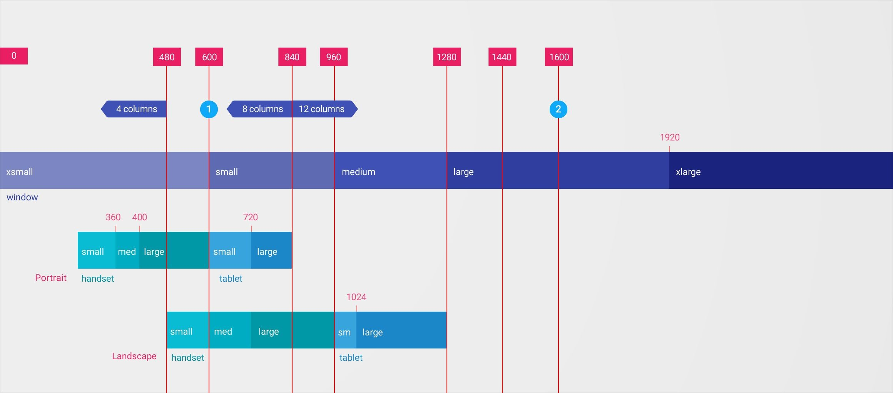
Material Breakpoint sizes: xs, sm, md, lg, xl
CS142 Lecture Notes - Web Apps

Slide 15
Material UI Breakpoints
Uses a simplified model based on screen width:
xs, extra-small: 0px or larger
sm, small: 600px or larger
md, medium: 960px or larger
lg, large: 1280px or larger
xl, extra-large: 1920px or larger
○

Slide 16
Material UI Responsive Support
Grid Component - Grid takes xs/sm/md/lg/xl= columns properties
<Grid item xs={12} md={6} xl={3}> ...
Hidden Component - Conditional rendering (xsUp, lgDown) deprecated ☹
<Hidden mdUp>
<Paper>This is a paper component except on md and bigger display</Paper>
</Hidden>
useMediaQuery React interface to @media
const theme = useTheme();
const matches = useMediaQuery(theme.breakpoints.up('md')); if (matches) ...

Slide 17
Accessibility
Accessible Rich Internet Applications (ARIA)
Provide text alternatives for any non-text content
  Add text descriptions for things that need it
<a aria-label="Photo of user {{user.name}}" href=...
<img aria-label="{{photo.description}}"
Provide alternatives for time-based media
  Transcripts, sub-titles, etc.
Work zoomed in, avoid quick timeouts, high contrast for foreground/background, work all keyboard and without keyboard, compatibility with assistive technologies, use simple sentences, etc.

Slide 18
Internationalization (I18N)
Users want different: text, dates, numbers, currencies, and graphics
Ultimately need a level of indirection. Consider: <h1>Getting Started</h1>
Example: react-i18next: Look up translation by key
  Hello <strong title="this is your name">{name}</strong>, you have {count} unread message(s).
  <Trans i18nKey="userMessagesUnread" count={count}>
Hello <strong title={t('nameTitle')}>{{name}}</strong>, you have {{count}} unread message.
</Trans>
Skip applying to user generated content

Slide 19
Testing the web app
Unit testing
  Each test targets a particular component and verifies it does what it claims it does
  Requires mock components for the pieces that component interacts with
  Example: Load an angular component (controller, directive, etc.) and run tests against it
    Need to mock everything these touch (DOM, angular services, etc.)
End-to-End (e2e) testing
  Run tests against the real web application
  Scripting interface into browser used to drive web application
  Example: Fire up app in a browser and programmatically interact with it.
    WebDriver interface in browsers useful for this
Metric: Test Coverage
  Does every line of code have a test?

